Slide 1
Location-aware application
& Challenges with mobility and wireless communication
Subject Name: Platform Based Development
Subject Code: PBDE401 | PBDV301
Lecturer Name : Freedom
Department : Information Technology

Slide 2
Outline of the lesson
Objectives :
Explain what location-aware applications and services are.
Describe key technologies enabling location awareness.
Identify real-world examples of location-aware systems across various industries.
Analyze challenges introduced by user mobility and wireless communication
Discuss solutions or strategies to overcome these challenges

Slide 3
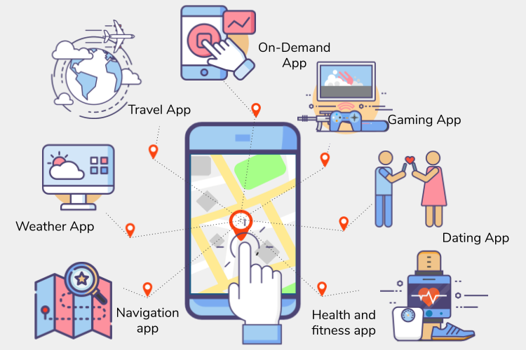
Location-aware applications/services
Location-aware applications leverage the geographical location of a user to provide personalized services, information, or functionality.
They rely on location data obtained from GPS, Wi-Fi, cellular networks, or other sensors to determine the user's position.
These applications offer a wide range of benefits, including navigation, social networking, geotagging, and location-based advertising.

Slide 4
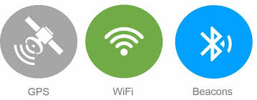
Technologies for Location awareness
GPS (Global Positioning System)- Utilizes satellites to determine the user's location.
Wi-Fi Positioning System (WPS)- Estimates location based on nearby Wi-Fi networks.
Cell ID - Uses the cell tower ID to approximate the user's location.
Bluetooth Beacons- Small devices that transmit signals to communicate with nearby smartphones
Other: Radio Frequency Identification (RFID), Computer Vision & Camera-Based Systems, Ultra-Wideband (UWB)
IP Address Geolocation ?

Slide 5
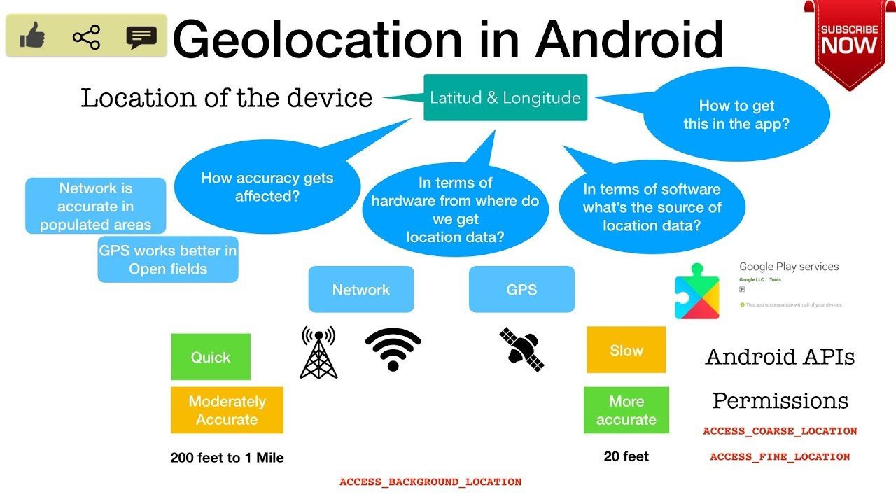
Location-awareness
in Android

Slide 6
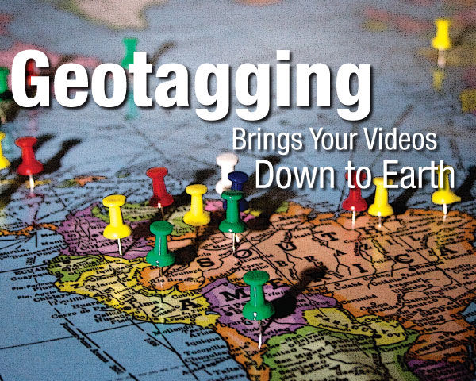
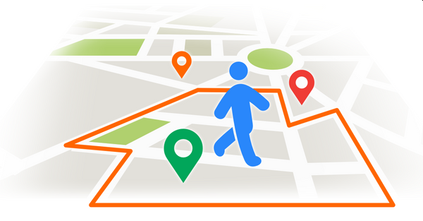

What is happening here?
Geofencing
Geotagging
Geotargeting

Slide 7
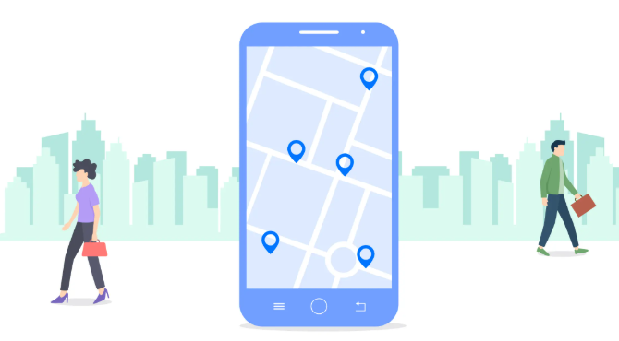
Challenges in location-aware apps
Battery Drain - Continuous use of GPS and other location services can drain the device's battery quickly.
Accuracy -Achieving high accuracy in location tracking, especially in urban areas with tall buildings or rural areas with limited GPS coverage, can be challenging.
Privacy Concerns - Balancing the need for location data with user privacy concerns is a constant challenge for developers.
Data Security - Ensuring that location data is securely stored and transmitted to prevent unauthorized access.
Compliance - Adhering to location-based advertising regulations and privacy laws in different regions can be complex.

Slide 8
Think Zone!!
ANSWER ME
1. Social Media Risk [ 15 marks ]
A teenager regularly posts photos on social media with geotags showing their exact location in real time.
  Analyse the potential privacy and security risks involved.
  Explain how this information could be misused by others.
  Recommend practical steps the teenager can take to reduce these risks.
2. Advertising [ 15 marks ]
A user notices that after visiting a hospital, they start receiving ads related to medical treatments.
  Explain how geotargeting could be responsible for this situation.
  Analyse the ethical concerns related to this type of targeting.
  Discuss whether this use of location data should be regulated.

Slide 9
Think Zone!!
ANSWER ME
3. Travel Blogging [ 15 marks ]
A travel blogger shares their live location while traveling to different places around the world.
Questions:
  Identify the risks associated with sharing live location publicly.
  Explain how geotagging can expose personal patterns or routines.
  Suggest safer alternatives for sharing travel experiences

Slide 10
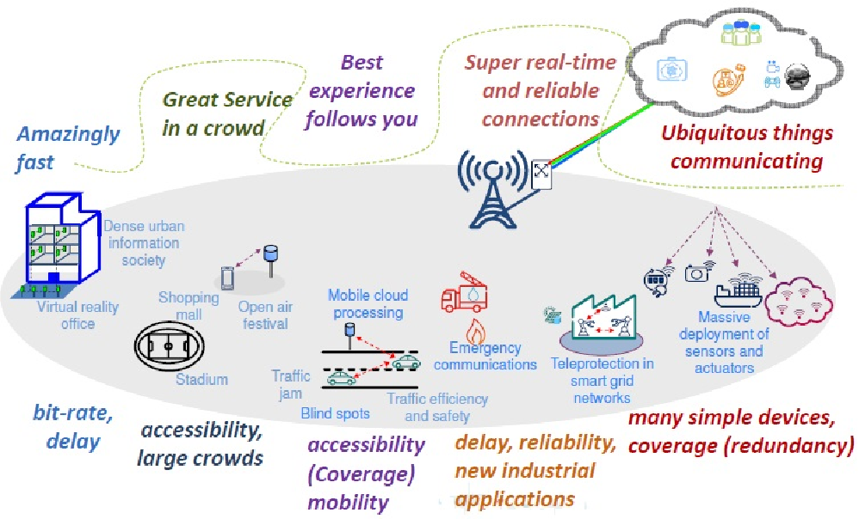
Mobility and Wireless Communication
Important considerations (Challenges)
Network Coverage & Connectivity
Bandwidth & Data Throughput
Energy Efficiency & Battery Life
Security & Privacy
Regulatory & Compliance

Slide 11
Conclusion
Location-aware applications offer significant benefits, enabling services across industries such as transportation, retail, and healthcare. Technologies such as GPS, Wi-Fi, and Bluetooth power these services, but challenges arise with mobility, including:
  Network Coverage & Connectivity – Use offline modes and network failover.
  Bandwidth & Data Throughput – Apply data compression and adaptive streaming.
  Energy Efficiency & Battery Life – Utilize low-power APIs and background throttling.
  Security & Privacy – Implement encryption and user consent controls.
  Regulatory & Compliance – Ensure compliance with data privacy laws.
  Balancing these challenges with effective solutions is key to delivering secure and efficient location-based services.

